Slide 1


Introduction to MongoDB
Explore MongoDB, a leading NoSQL document database. Key features include scalability, flexibility, and high performance. Common in web apps, IoT, mobile, and big data workflows. Compare MongoDB with relational SQL databases. Available in Community and Enterprise editions to suit different needs.
by Sk Mahaboobbasha

Slide 2

Understanding Core MongoDB Concepts
Documents & Collections
Data stored as flexible JSON-like documents organized in collections.
BSON Format
Binary JSON format for efficient storage and fast processing.
CRUD Operations
Basic database actions: create, read, update, and delete data.
Querying & Data Types
Supports rich queries on various data types for precise filtering.

Slide 3
Effective Data Modeling in MongoDB
Modeling Principles
Relationship Types
Design schema for performance and flexibility.
One-to-one, one-to-many, and many-to-many relationships impact design.
Embed related data when fast reads needed
Reference for normalization or large data
Choose embedding for one-to-few relationships
Balance schema complexity with application needs
Use referencing for large or evolving datasets
Optimize queries based on relationships

Slide 4

Mastering Indexing in MongoDB
Importance of Indexes
Speeds queries by reducing data scanning.
Types of Indexes
Single field, compound, geospatial, and text indexes.
Optimization
Choose proper index types and fields carefully.
Monitoring
Use tools to analyze index usage and performance.

Slide 5
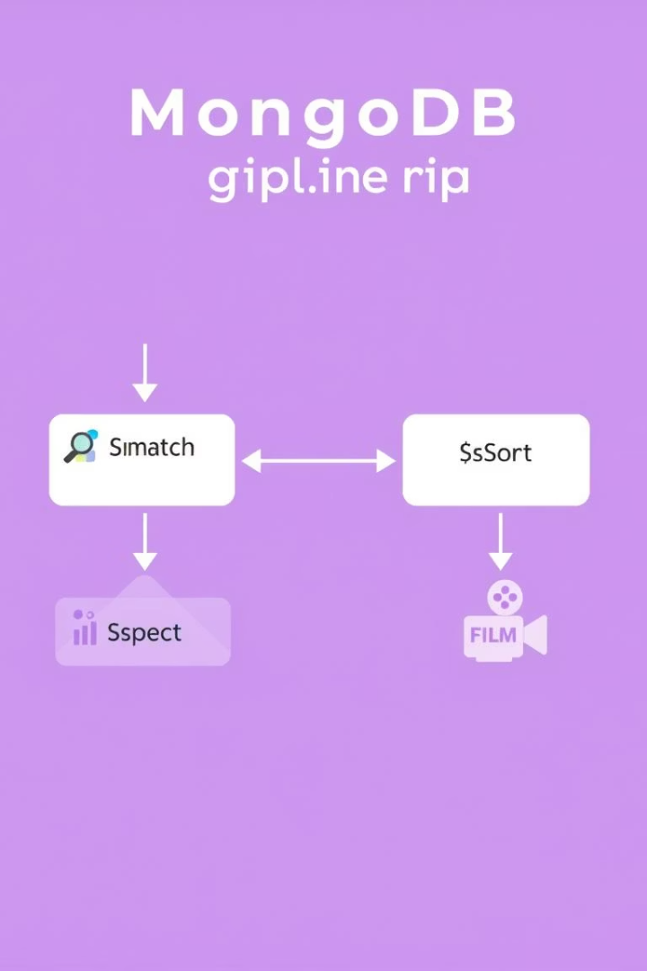




Harnessing the Aggregation Framework
$match
Filters documents to select relevant data for analysis.
$group
Aggregates data by grouping based on specified fields.
$project & $unwind
Reshapes documents and flattens arrays for detailed processing.
Optimization & Use Cases
Craft efficient pipelines for reporting and analytics needs.

Slide 6

Scaling with MongoDB Sharding
What is Sharding?
Distributes data across multiple servers for scalability.
Shard Key Selection
Crucial for balanced data distribution and query efficiency.
Configuring Clusters
Setting up shards, config servers, and routers (mongos).
Balancing Data
Automatic rebalancing optimizes storage and performance.

Slide 7





Replication and High Availability
Setup
Replica Sets
Configure primary and secondary nodes for replication.
2
Groups of nodes providing failover and data redundancy.
1
Failover
Automatic election on primary failure ensures uptime.
3
Availability
5
Designed to keep systems running continuously without data loss.
Read Preferences
4
Control how queries route to primary or secondary nodes.

Slide 8

MongoDB Administration & Performance Tuning
Performance Monitoring
Query Optimization
Track key metrics to spot issues early.
Use indexes and analyze slow queries carefully.
Profiling & Logging
Backup & Recovery
Enable detailed diagnostics for troubleshooting.
Implement strategies to ensure data safety and availability.

